Slide 1
Breast Cancer Classification
DRASTI N VADHAR- PES1201700686
G SHREYA - PES1201700084
ISHWAR CHOUDHARY- PES1201700189

Slide 2
USP
Implemented 2 Supervised Learning models-
Neural Networks
K Nearest Neighbors
For Visualization: ‘K Means Clustering’
Found optimum K value
Can further use K means to implement 1 Nearest Neighbor trained on cluster centroids.
Could also use K means to train SVM on resulting clusters.

Slide 3
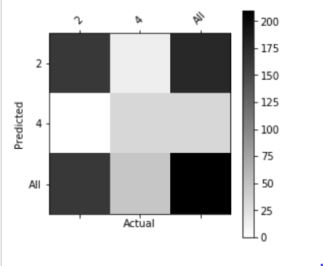
Neural Networks
Accuracy-88.0476%
1 hidden layer
Activation Unit- Sigmoid

Slide 4
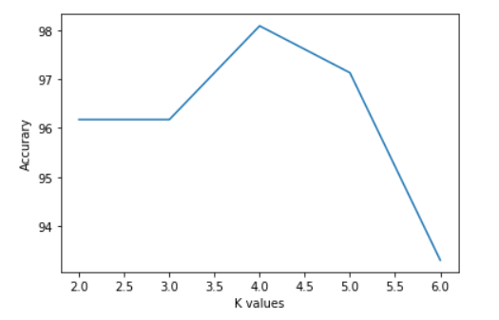
K Nearest Neighbors
Implemented with K fold validation
Average accuracy -97%
Used Euclidean Distance
Optimum K value =4

Slide 5
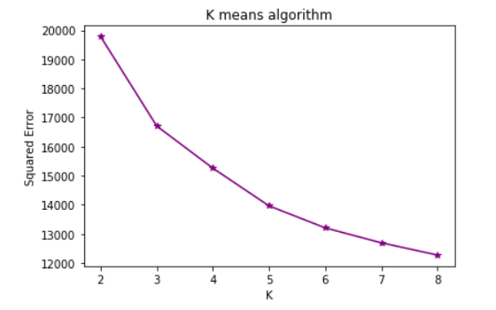
Visualization:
K Means Clustering
Running K means clustering for values of k between 2-8
Optimum K value is found to be 4

Slide 6
Thank You!

